Slide 1


Golden Retrieval Project
Touché Problem
UNIVERSITÀ
DEGLI STUDI
DI PADOVA
DIPARTIMENTO
DI INGEGNERIA
DELL’INFORMAZIONE
Golden Retrieval Team : A. Cassetta, A. Piva and E. Vicentini
Master Degree in Computer Engineering
Search Engines Course – Prof. Nicola ferro
Academic Year 2020/2021
University of Padua – Department of Information Engineering

Slide 2




Initial attempts
Parsing documents
  Parser 0
  Parser 1
  Parser 2
Query expansion
  OpenAI GPT-2
  Randomly weighted synonyms
Minimum body length
Re-ranking with discussion ID
OpenNLP attempt
Parser | Term Count | Storage (MB) | Time (seconds) | Time ratio
P0 | 1078017 | 195 | 99 | 1,00
P1 | 1196289 | 1745 | 507 | 5,12
P2 | 1153517 | 706 | 249 | 2,52

Slide 3

Our approach
We start form the dataset files in JSON format (387 740 arguments)
Jackson library
Parser 0 which takes premises, conclusions, documents’ title and the stance attribute (PRO or CONS)
We use Apache Lucene as baseline of our project and so we start develop our code for it. In particular we have divided our con in five files:
ArgsParser;
ShanksAnalyzer;
DirectoryIndexer;
Searcher
ShanksTouche

Slide 4
Indexing part
Index composed by:
Document ID
Title
Body
Stance
StandardTokenizer
It uses the following files:
ArgsParser;
ShanksAnalyzer;
DirectoryIndexer;
LowerCaseFilter
EnlishPossesiveFilter
StopFilter

Slide 5

Searching part
Boolean query with:
Weighted query terms
WordNet synonyms
Proximity parameter
Similarity used:
MB25Similarity
LMDrichletSimilarity
MultiSimilarity

Slide 6
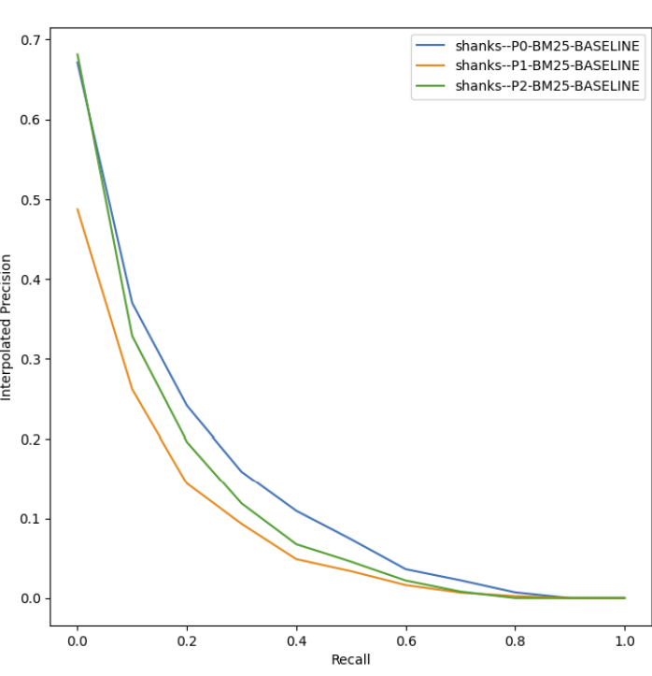
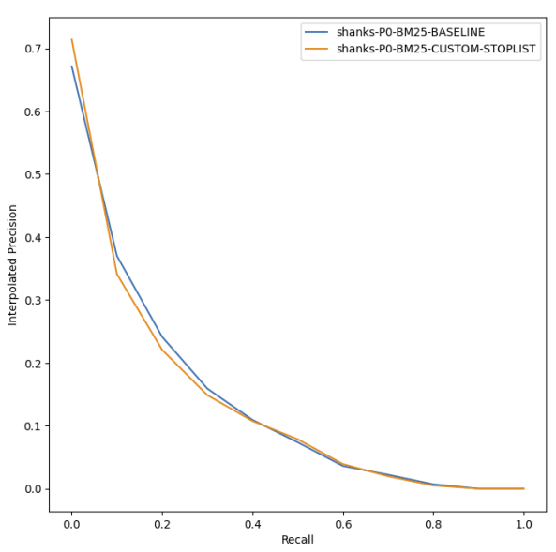
Baseline and test
Feature used:
BM25Similarity
Lucene default stop-list

Slide 7
Some results
Query | Similarity | tBoost | sBoost | pBoost | pDist
maxRecall | MULTI | 3,50 | 0,15 | 1,75 | 12
maxnDCG | LMD | 0,00 | 0,05 | 0,75 | 15
Optimal parameter obtained on the 2020 topics without description
Query | Similarity | tBoost | sBoost | pBoost | pDist
maxRecall | MULTI | 3,50 | 0,15 | 1,75 | 12
maxnDCG | LMD | 0,30 | 0,05 | 1,75 | 15
Optimal parameter obtained on the 2020 topics with description

Slide 8
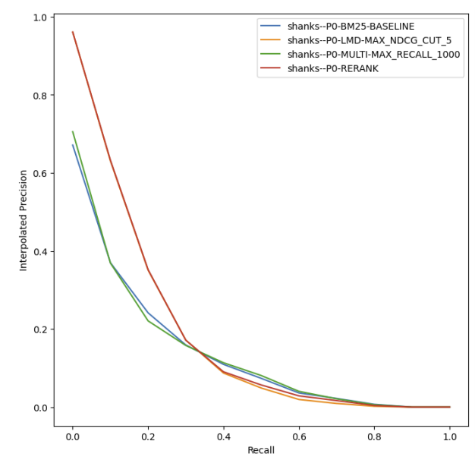
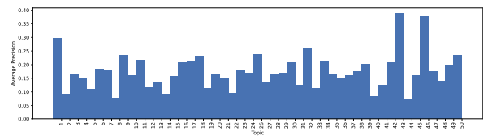
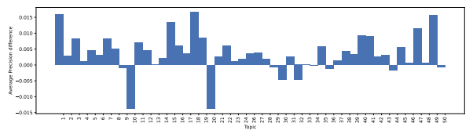
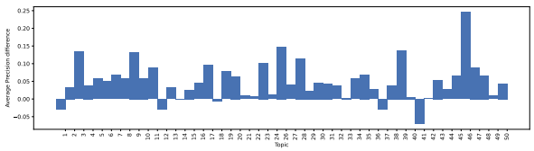
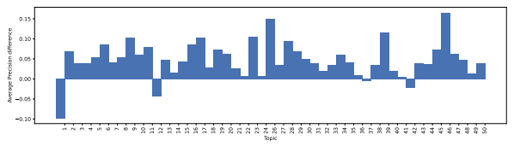
Some results
Topic Average Precision for the re-Raking approach
Topic Average Precision Difference = AP re-ranking – AP maxnDCG
Topic Average Precision Difference = AP re-ranking – AP p0
Topic Average Precision Difference = AP re-ranking – AP maxRecall

Slide 9
Conclusion results
RUNb | num_rel_ret | Map | P_5 | Recall_1000 | nDCG | nDCG@5
P0-RERANK | 1263 | 0,1750 | 0,6490 | 0,6631 | 0,4979 | 0,5495
P0-LMD-MAX_nDCG@5 | 1103 | 0,1717 | 0,6490 | 0,5803 | 0,4764 | 0,5495
P0-MULTI-MAX_RECALL_1000 | 1263 | 0,1276 | 0,4082 | 0,6631 | 0,4283 | 0,3117
P0-BM25-Baseline | 1250 | 0,1256 | 0,3796 | 0,6563 | 0,4216 | 0,2871
RUN | num_rel_ret | Map | P_5 | Recall_1000 | nDCG | nDCG@5
Run-1 | 1263 | 0,1750 | 0,6490 | 0,6631 | 0,4979 | 0,5495
Run-2 | 1255 | 0,1735 | 0,6408 | 0,6588 | 0,4960 | 0,5432
Run-3 | 1103 | 0,1717 | 0,6490 | 0,5803 | 0,4764 | 0,5495
Run-4 | 1199 | 0,1497 | 0,4816 | 0,6312 | 0,4536 | 0,3866
Run-5 | 1263 | 0,1276 | 0,4082 | 0,6631 | 0,4283 | 0,3117
RUN | num_rel_ret | Map | P_5 | Recall_1000 | nDCG | nDCG@5
Run-1 | 795 | 0,3146 | 0,6245 | 0,8705 | 0,6521 | 0,6407
Run-2 | 790 | 0,3126 | 0,5959 | 0,8671 | 0,6521 | 0,6213
Run-3 | 770 | 0,3141 | 0,6245 | 0,8502 | 0,6479 | 0,6407
Run-4 | 788 | 0,2546 | 0,4327 | 0,865 | 0,5839 | 0,4391
Run-5 | 795 | 0,2565 | 0,449 | 0,8705 | 0,588 | 0,4513

Slide 10
Statistical Analysis
Our subject
5 runs submitted to touché 2021
Run 1:
Re-Ranking approach.
Our best retrieval model
Run 4:
maxnDCGquery with MultiSimilarity
Run 2:
(like run1) proximity searches are only with pairs of subsequent tokens
Run 5:
maxRecallquery with MultiSimilarity
Run 3:
maxnDCGquery with LMDirichletSimilarity

Slide 11
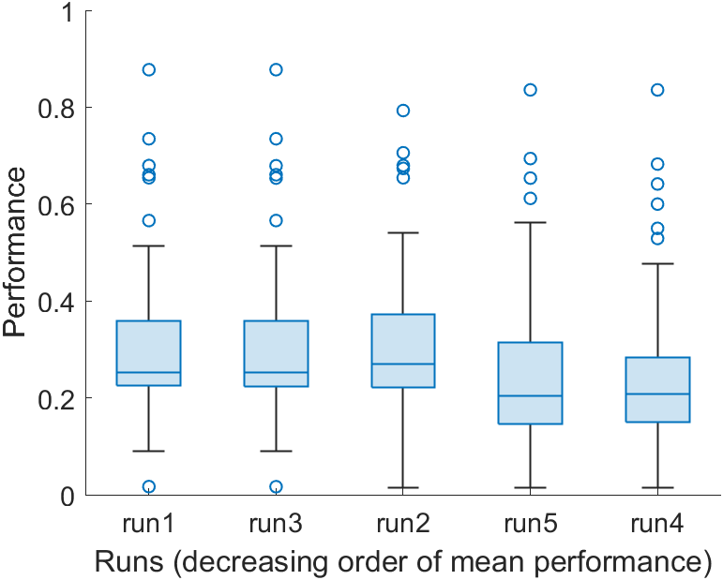
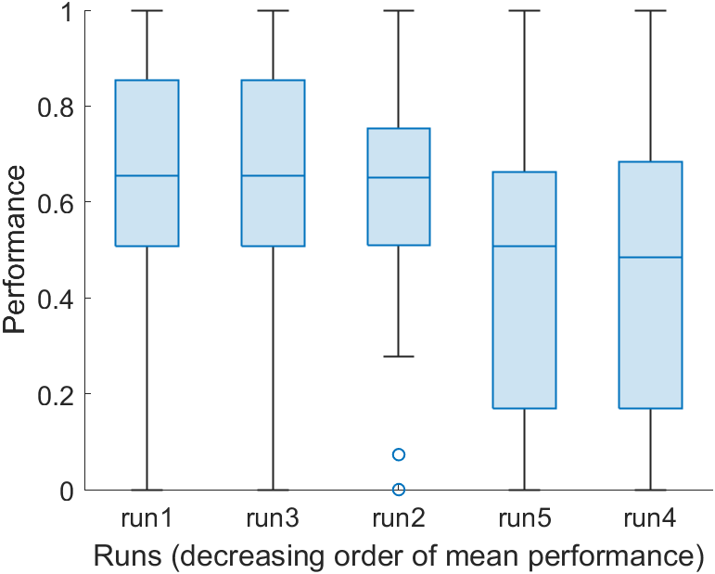
Statistical Analysis
Graphical summary
Boxplot
MAP
NDCG@5
Higher performance for nDCG@5
Many outliers for MAP
Similarities are clearly visible

Slide 12
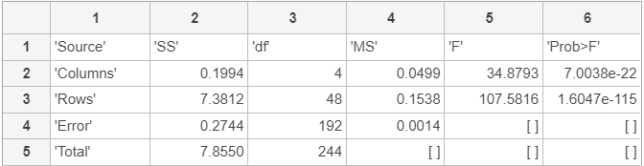
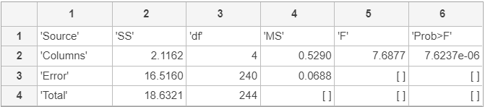
Statistical Analysis
ANOVA
One-way & Two-way
MAP
Two-way ANOVA:
Less error compared to One-way ANOVA because of topics effect
At least one of the runs
has different mean
from the others
NDCG@5

Slide 13
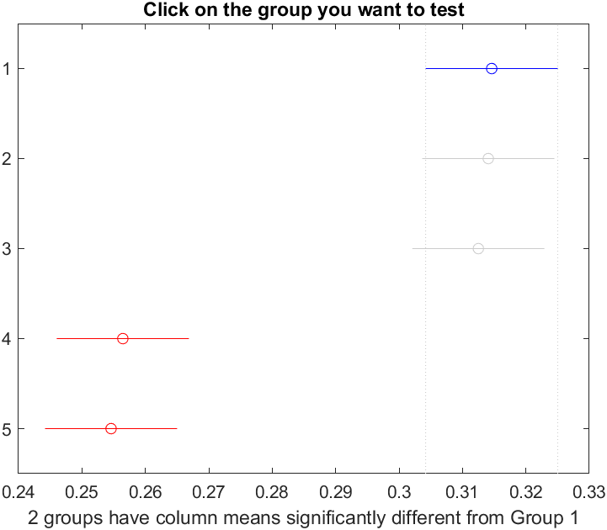
Statistical Analysis
From ANOVA to
multiple comparison
This test enables to determine which pairs of group means are significantly different. (series of t-tests)
MAP
Run 1
Run 3
Run 2
Prevent the TYPE I ERROR
Tukey’s honestly significant difference criterion (HSD). Produce a familywise error rate of 0.05
Run 5
Run 4
Similar graph also for nDCG@5

Slide 14
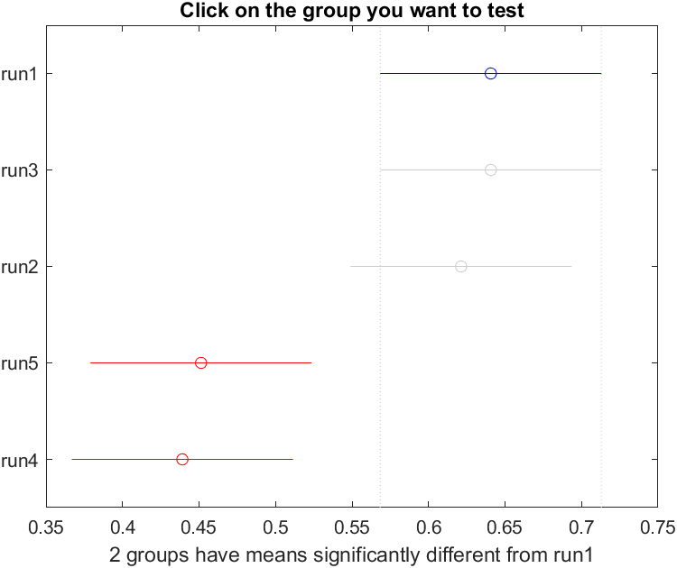
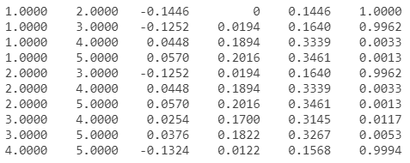
Statistical Analysis
Tukey’s t-Test
RUN 3 vs RUN 4
NDGC@5
Run 3: maxnDCG -
LMDirichletSimilarity
p-value
if < 0.05 then I reject H₀
Run 4: maxnDCGquery - MultiSimilarity

Slide 15
Failure Analysis
BEST MAP
Position | Topic number | Query | Map value
1 | 42 | Should fighting be allowed in hockey? | 0.8774
2 | 43 | Should bottled water be banned? | 0.7348
3 | 1 | Should teachers get tenure? | 0.6795
4 | 50 | Should everyone get a universal basic income? | 0.6605
5 | 46 | Should net neutrality be restored? | 0.6542

Slide 16
Failure Analysis
WORST MAP
Position | Topic number | Query | Map value
50 | 44 | Should fighting be allowed in hockey? | 0.8774
49 | 12 | Should bottled water be banned? | 0.0894
48 | 22 | Should teachers get tenure? | 0.0910
47 | 8 | Should everyone get a universal basic income? | 0.1035
46 | 40 | Should net neutrality be restored? | 0.0168

Slide 17
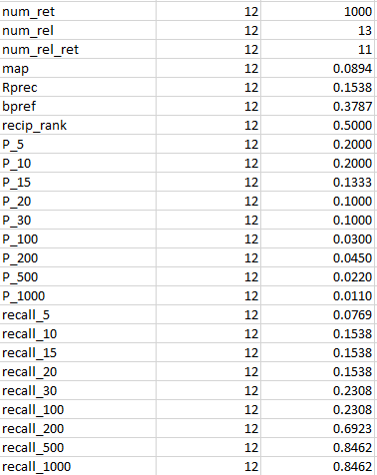
Failure Analysis
Low starting recall
Main central growth
between 100 - 200
Solution:
Quality analysis

Slide 18
Thank you for your attention
Golden Retrieval Team : A. Cassetta, A. Piva and E. Vicentini

